Slide 1
Radix sort

Slide 2
Outline
This topic covers radix sort:
Bucket sort is Θ(n + m)
Is it possible to capitalize on the linear behaviour?
Consider sorting digits

Slide 3
Radix Sort
Suppose we want to sort 10 digit numbers with repetitions
We could use bucket sort, but this would require the use of 10¹⁰ buckets
With one byte per counter, this would require 9 GiB
This may not be very practical…

Slide 4
Radix Sort
Consider the following scheme
Given the numbers
16 31 99 59 27 90 10 26 21 60 18 57 17
If we first sort the numbers based on their last digit only, we get:
90 10 60 31 21 16 26 27 57 17 18 99 59
Now sort according to the first digit:
10 16 17 18 21 26 27 31 57 59 60 90 99

Slide 5
Radix Sort
The resulting sequence of numbers is a sorted list
Thus, consider the following algorithm:
Suppose we are sorting decimal numbers
Create an array of 10 queues
For each digit, starting with the least significant
Place the ith number in to the bin corresponding with the current digit
Remove all digits in the order they were placed into the bins in the order of the bins

Slide 6
Radix Sort
Suppose that two n-digit numbers are equal for the first m digits:
a = a_{n}a_{n – 1}a_{n – 2}...a_{n – m + 1}a_{n – m}...a₁a₀
b = a_{n}a_{n – 1}a_{n – 2}...a_{n – m + 1}b_{n – m}...b₁b₀
where a_{n – m} < b_{n – m}
For example, 103574 < 103892 because 1 = 1, 0 = 0, 3 = 3 but 5 < 8
Then, on iteration n – m, a will be placed in a lower bin than b
When they are taken out, a will precede b in the list

Slide 7
Radix Sort
For all subsequent iterations, a and b will be placed in the same bin, and will therefore continue to be taken out in the same order
Therefore, in the final list, a must precede b

Slide 8
Example 1
Sort the following decimal numbers:
86 198 466 709 973 981 374 766 473 342
First, interpret 86 as 086

Slide 9
Example 1
Next, create an array of 10 queues:
0
1
2
3
4
5
6
7
8
9

Slide 10
Example 1
Push according to the 3rd digit:
086 198 466 709 973 981 374 766 473 342
and dequeue: 981 342 973 473 374 086 466 766 198 709
0
1 | 981
2 | 342
3 | 973 | 473
4 | 374
5
6 | 086 | 466 | 766
7
8 | 198
9 | 709

Slide 11
Example 1
Enqueue according to the 2nd digit:
981 342 973 473 374 086 466 766 198 709
and dequeue: 709 342 466 766 973 473 374 981 086 198
0 | 709
1
2
3
4 | 342
5
6 | 466 | 766
7 | 973 | 473 | 374
8 | 981 | 086
9 | 198

Slide 12
Example 1
Enqueue according to the 1st digit:
709 342 466 766 973 473 374 981 086 198
and dequeue: 086 198 342 374 466 473 709 766 973 981
0 | 086
1 | 198
2
3 | 342 | 374
4 | 466 | 473
5
6
7 | 709 | 766
8
9 | 973 | 981

Slide 13
Example 1
The numbers
086 198 342 374 466 473 709 766 973 981
are now in order
The next example uses the binary representation of numbers, which is even easier to follow

Slide 14
Example 2
Sort the following base 2 numbers:
1111 11011 11001 10000 11010 101 11100 111 1011 10101
First, interpret each as a 5-bit number:
01111 11011 11001 10000 11010 00101 11100 00111 01011 10101
Next, create an array of two queues:
0
1

Slide 15
Example 2
Place the numbers 01111 11011 11001 10000 11010 00101 11100 00111 01011 10101
into the queues based on the 5th bit:
Remove them in order:
10000 11010 11100 01111 11011 11001 00101 00111 01011 10101
0
1
0 | 10000 | 11010 | 11100
1 | 01111 | 11011 | 11001 | 00101 | 00111 | 01011 | 10101

Slide 16
Example 2
Place the numbers 10000 11010 11100 01111 11011 11001 00101 00111 01011 10101
into the queues based on the 4th bit:
Remove them in order:
10000 11100 11001 00101 10101 11010 01111 11011 00111 01011
0 | 10000 | 11100 | 11001 | 00101 | 10101
1 | 11010 | 01111 | 11011 | 00111 | 01011
0
1

Slide 17
Example 2
Place the numbers 10000 11100 11001 00101 10101 11010 01111 11011 00111 01011
into the queues based on the 3rd bit:
Remove them in order:
10000 11001 11010 11011 01011 11100 00101 10101 01111 00111
0 | 10000 | 11001 | 11010 | 11011 | 01011
1 | 11100 | 00101 | 10101 | 01111 | 00111
0
1

Slide 18
Example 2
Place the numbers 10000 11001 11010 11011 01011 11100 00101 10101 01111 00111
into the queues based on the 2nd bit:
Remove them in order:
10000 00101 10101 00111 11001 11010 11011 01011 11100 01111
0 | 10000 | 00101 | 10101 | 00111
1 | 11001 | 11010 | 11011 | 01011 | 11100 | 01111
0
1

Slide 19
Example 2
Place the numbers 10000 00101 10101 00111 11001 11010 11011 01011 11100 01111
into the queues based on the 1st bit:
Remove them in order:
00101 00111 01011 01111 10000 10101 11001 11010 11011 11100
0 | 00101 | 00111 | 01011 | 01111
1 | 10000 | 10101 | 11001 | 11010 | 11011 | 11100
0
1

Slide 20
Example 2
The numbers
00101 00111 01011 01111 10000 10101 11001 11010 11011 11100
are now in order
This required 5n enqueues and dequeues
In this case, it n = 10

Slide 21
Sorting binary numbers
The implementation of the queues may require a lot of memory, especially if dynamic memory allocation is not possible
With only two buckets, we can always fill an array from either end:
Enqueue 0 at the front
Enqueue 1 at the back
Mirror the 1s after all enqueues are preformed

Slide 22
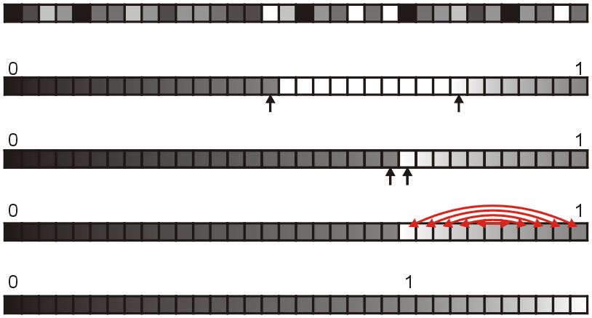
Sorting binary numbers
This demonstrates the idea:
Unordered:
Start enqueing:
Finish enqueing:
Swap 2nd queue:
Finished:

Slide 23
Sorting binary numbers
Thus, an array of n binary numbers may be sorted using exactly one additional array of size n
The two queues use the same array
Reversing the second queue also runs in Θ(n)

Slide 24
Run-time analysis
Bucket sort is Θ(n + m) where m is the number of buckets
Restricting ourselves to either decimal digits or bits ensures that m = Θ(1)
How often must we iterate to sort numbers on the range 0, …, N – 1?
We require ⌊log₁₀(N)⌋ + 1 digits or ⌊log₂(N)⌋ + 1 bits
This is why Arabic numbers are so powerful
Run time is therefore Θ(n ln(N))
For this to be faster than previous sorting algorithms, it must be true that ln(N) < ln(n) or N << n
Therefore, it is only truly useful if we are sorting lists of relatively small numbers with very significant amount of duplications

Slide 25
Run-time analysis
The following table summarizes the run-times of bucket sort for sorting n numbers on the range 0, …, N – 1
It requires Θ(n) memory for the queues
It is only useful to use radix sort over quicksort if n = ω(N)
Case | Run Time | Comments
Worst | Θ(n ln(N)) | No worst case
Average | Θ(n ln(N))
Best | Θ(n ln(N)) | No best case

Slide 26
Sorting a million 32-bit integers
Senator Obama was asked
“What is the most efficient way to sort a million 32-bit integers.”
Many claim that radix sort would be fastest
What is the problem?
Radix sort would require 32 million comparisons
Quicksort would require approximately 20 million comparisons

Slide 27
Summary
Radix sort uses bucket sort on each digit of a set of numbers
Interesting in theory, less useful in practice
Useful only if sorting numbers with significant duplication
The idea is used elsewhere

Slide 28
References
[1] Donald E. Knuth, The Art of Computer Programming, Volume 3: Sorting and Searching, 2nd Ed., Addison Wesley, 1998, §5.2.3, p.144-8.
[2] Cormen, Leiserson, and Rivest, Introduction to Algorithms, McGraw Hill, 1990, Ch. 7, p.140-9.
[3] Weiss, Data Structures and Algorithm Analysis in C++, 3rd Ed., Addison Wesley, §7.5, p.270-4.

Slide 29
References
Wikipedia, http://en.wikipedia.org/wiki/Radix_sort
[1] Donald E. Knuth, The Art of Computer Programming, Volume 3: Sorting and Searching, 2nd Ed., Addison Wesley, 1998, §5.2.3, p.144-8.
[2] Cormen, Leiserson, and Rivest, Introduction to Algorithms, McGraw Hill, 1990, Ch. 7, p.140-9.
[3] Weiss, Data Structures and Algorithm Analysis in C++, 3rd Ed., Addison Wesley, §7.5, p.270-4.
These slides are provided for the ECE 250 Algorithms and Data Structures course. The material in it reflects Douglas W. Harder’s best judgment in light of the information available to him at the time of preparation. Any reliance on these course slides by any party for any other purpose are the responsibility of such parties. Douglas W. Harder accepts no responsibility for damages, if any, suffered by any party as a result of decisions made or actions based on these course slides for any other purpose than that for which it was intended.

